Slide 1

Book My Doc
By Akash Reddy Bommireddy

Slide 2

Introduction
The "BookMyDoctor" application revolves around creating a user-friendly and efficient platform for patients to seamlessly interact with healthcare providers and take control of their healthcare requirements.

Slide 3
Roles Involved in the BOOKMYDOC application
Administration – Admins
Doctors
Patients

Slide 4

ADMINS
Approves doctors registered in the application.
01
Add/Update/Remove Specializations
02
Add/Update/Remove Hospitals
03
Can view all the appointments
04

Slide 5

Doctors
Register on the platform, undergo admin review for approval, and become a part of the application.
Set available schedules for appointments as a doctor.
Review and approve or reject appointment requests.
Update the appointment status and prescribe medications after consultations are finished in the tool.

Slide 6
Patients
Register within the application.
1
Search for a specific specialization and schedule an appointment with a doctor by selecting an available date and slot.
2
Cancel appointments if they haven't been rejected or approved.
3
Reschedule appointments as needed.
4
Access and view prescriptions stored within the tool.
5

Slide 7
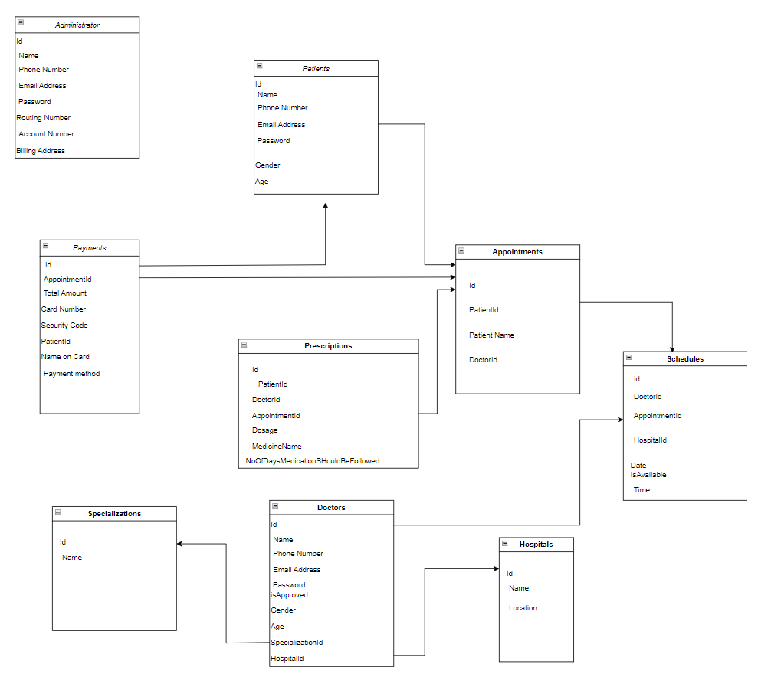
Database Model

Slide 8
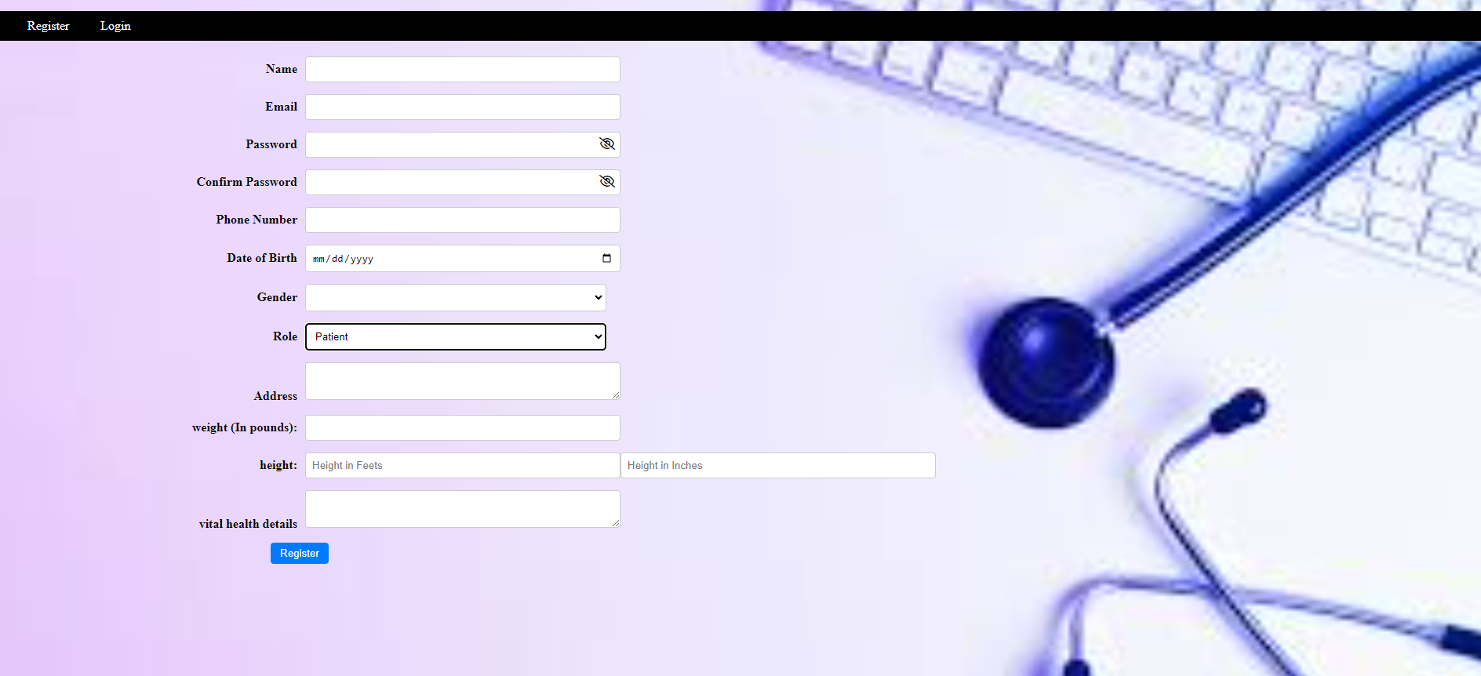
Register screen for Patient

Slide 9
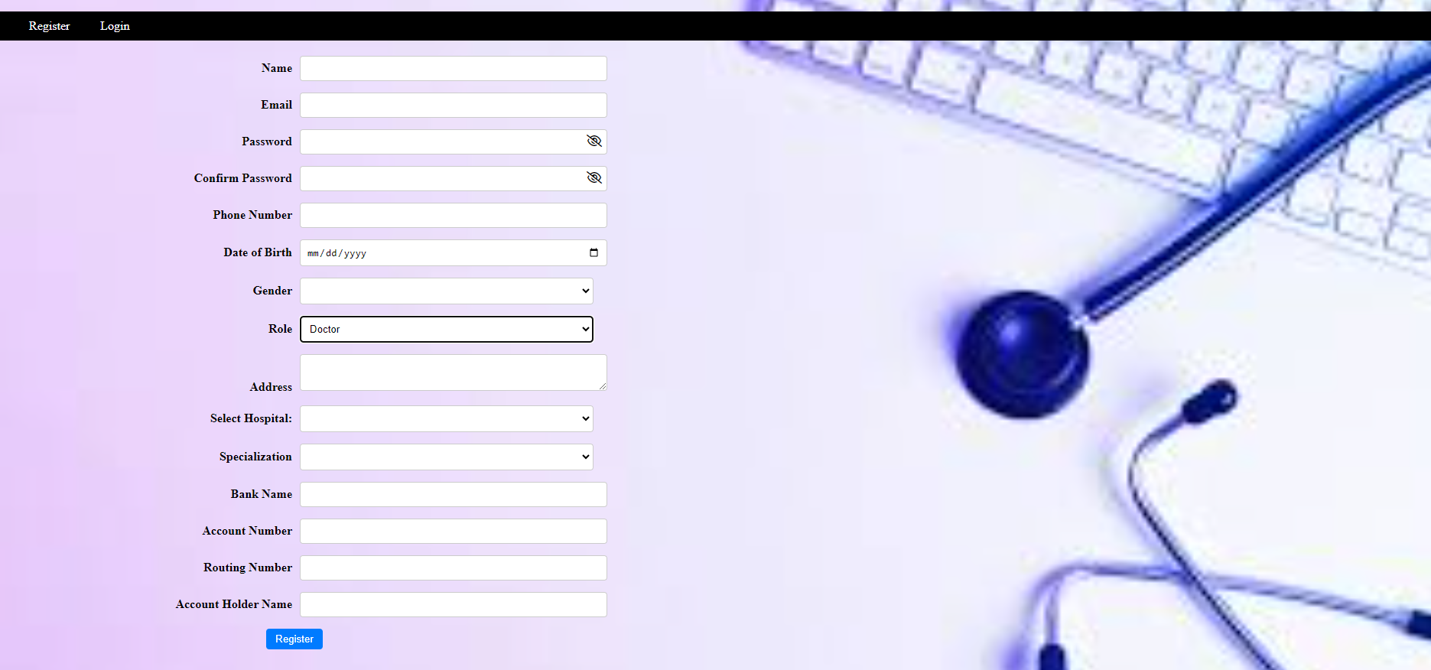
Register for Doctor

Slide 10
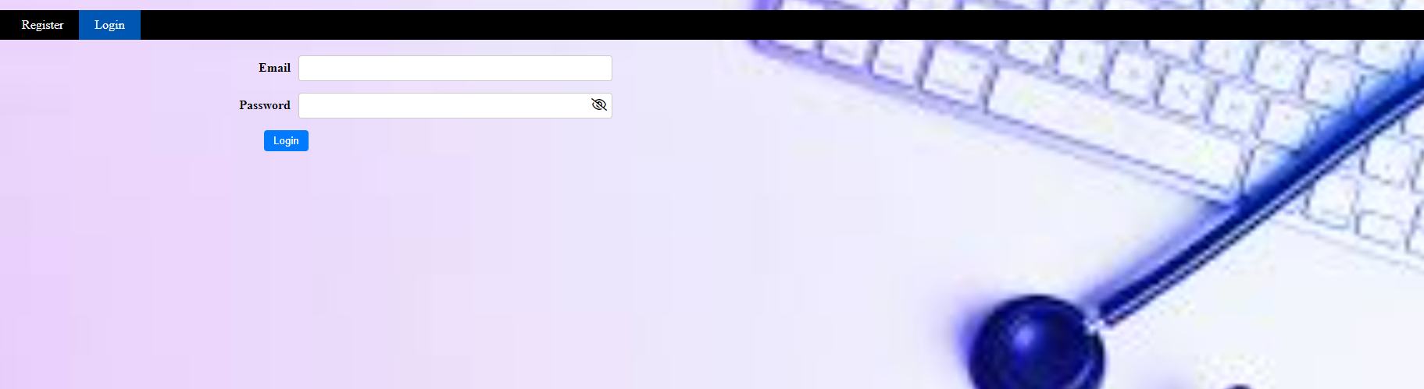
Login Screen

Slide 11
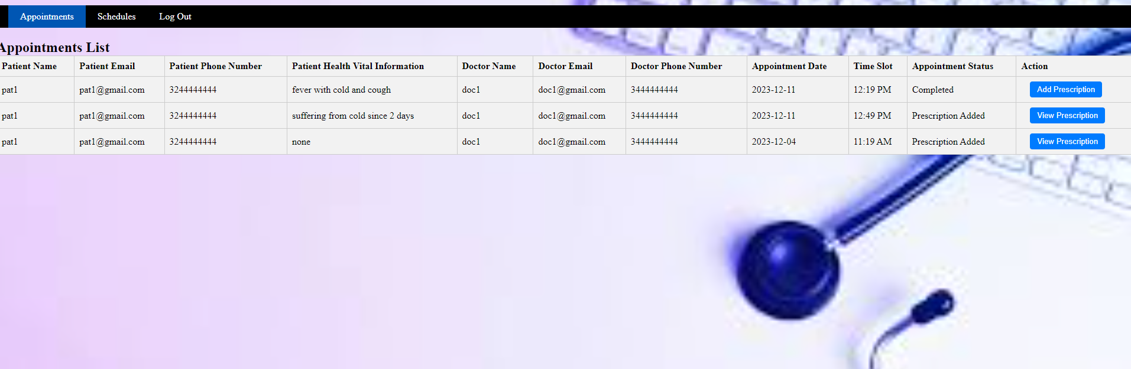
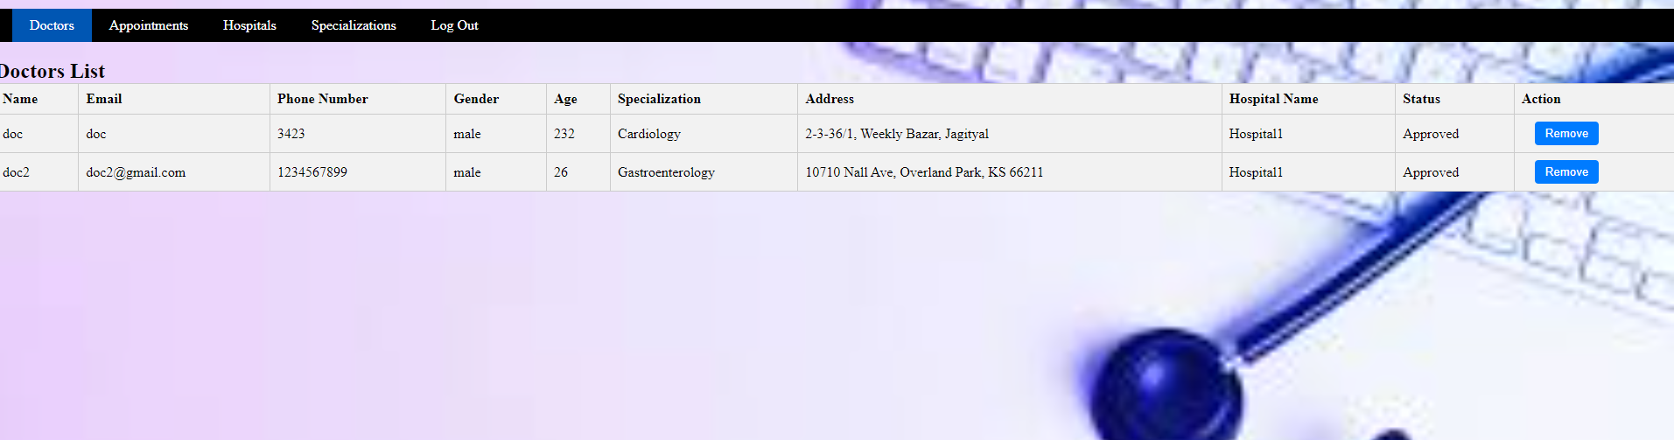
Doctors view for doctors list

Slide 12
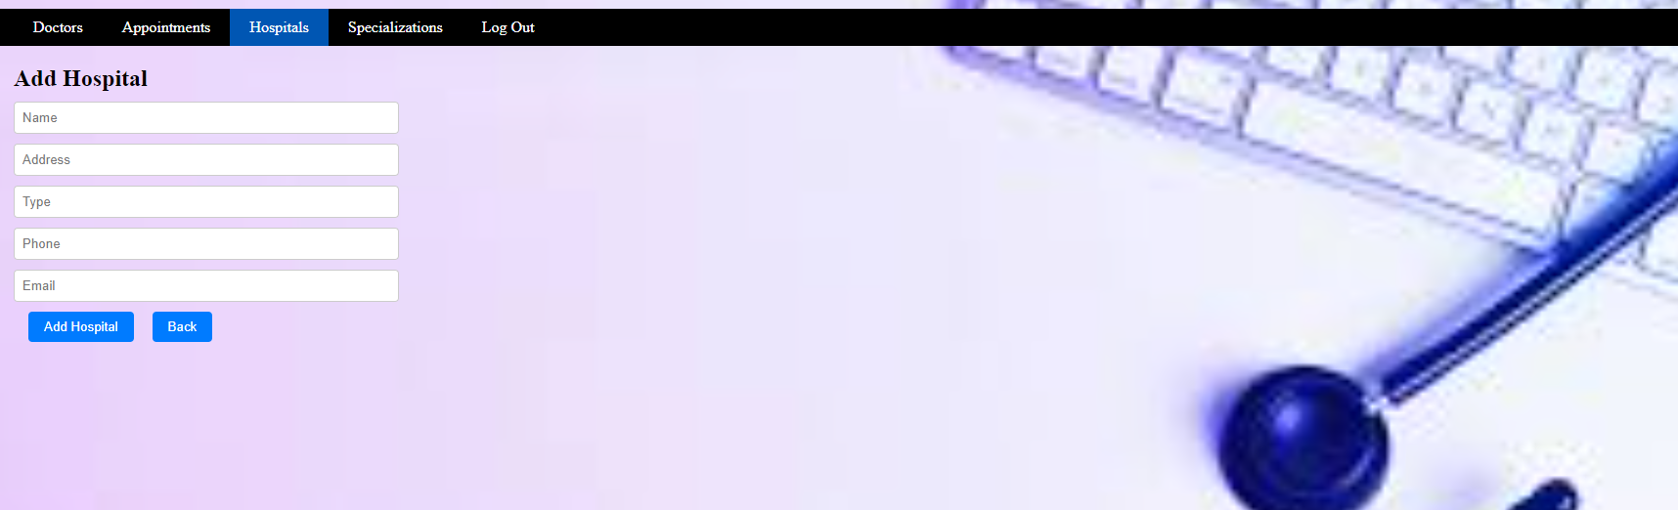
Add new Hospital

Slide 13
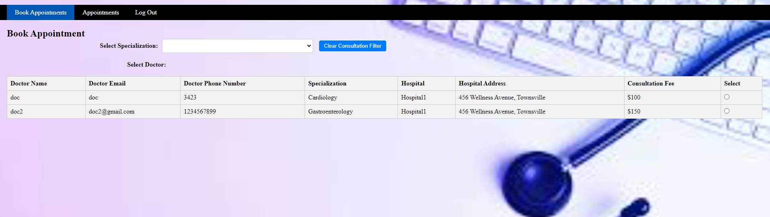
Patients booking an appointment

Slide 14
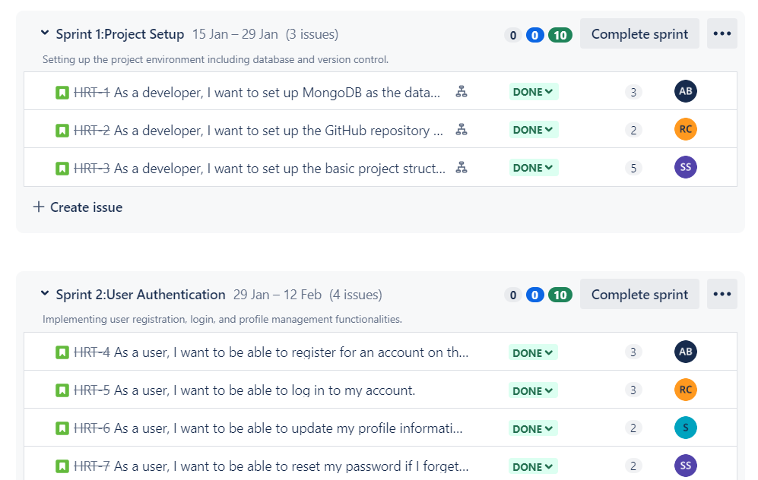

Slide 15
Highlights of Remaining Sprints
Remaining Sprint Objectives:
Schedules view for Doctors
Prescription Add and view for a doctor for an appointment
Hospitals view for admins
Add new Hospital
Update Hospital Details
Admin Functionalities
Focus on User Experience
Streamlining Appointment Booking Process
Improving Performance and Scalability
Enhancing Security Measures

Slide 16
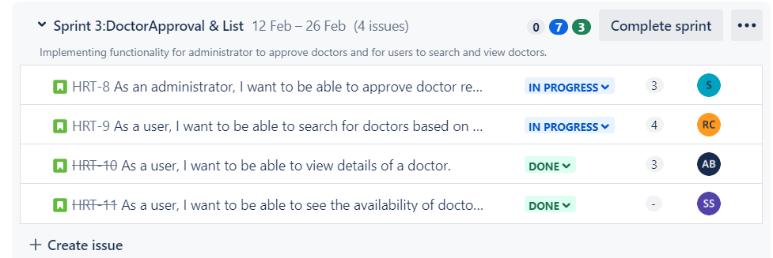

Slide 17
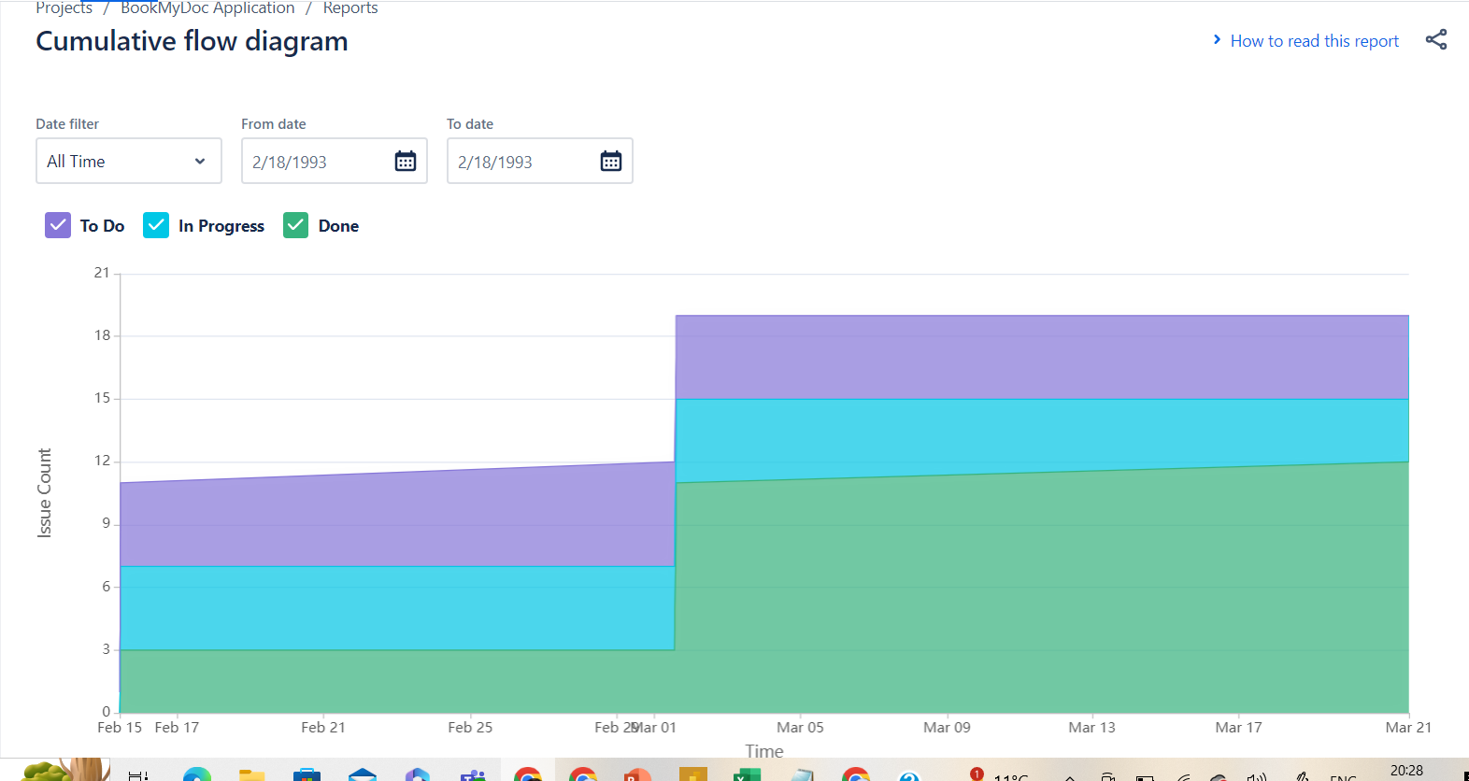
Sprint Reports

Slide 18
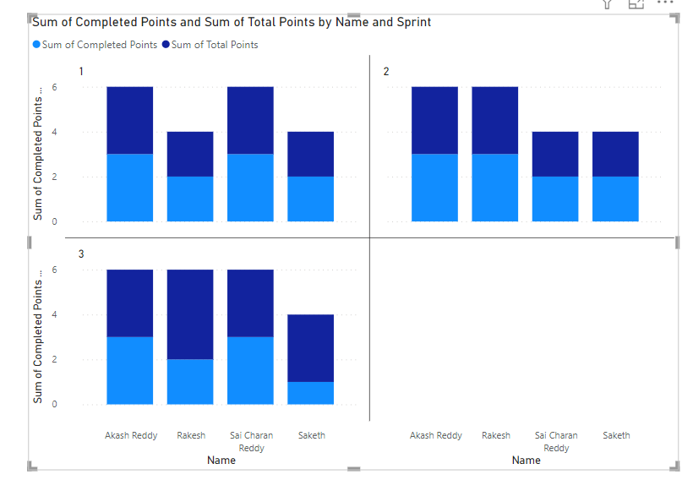

Slide 19

Thankyou

